Slide 1
2D Game development using Java
Super Mario Bros.

Slide 2
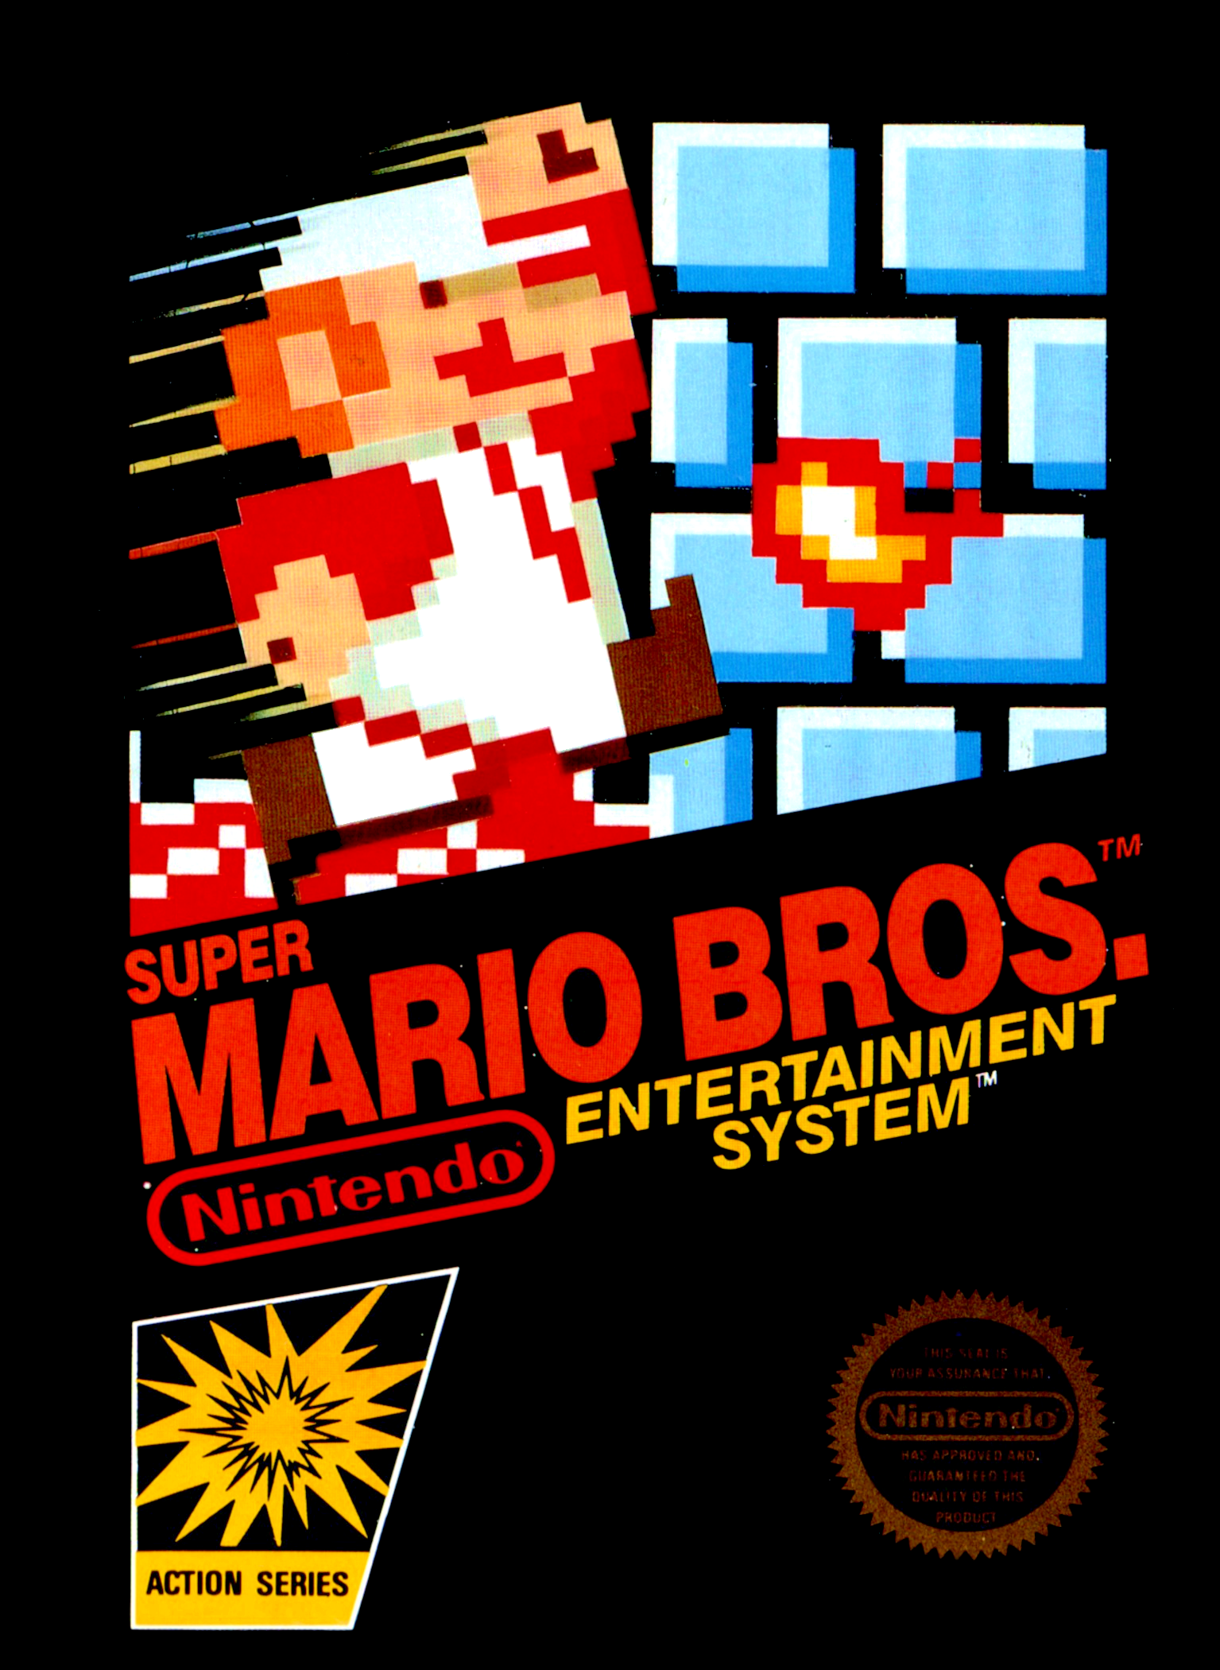

Slide 3
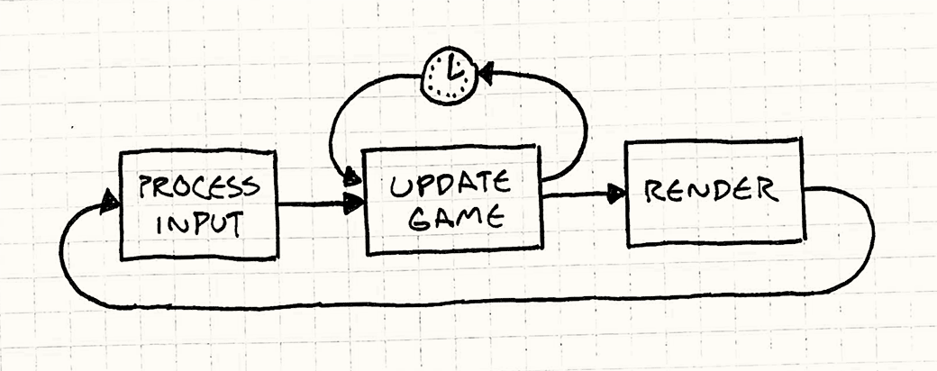
Basics
An infinite loop
Contains objects known as Entities
Entities wait for an input
Entities are updated
Entities are drawn

Slide 4
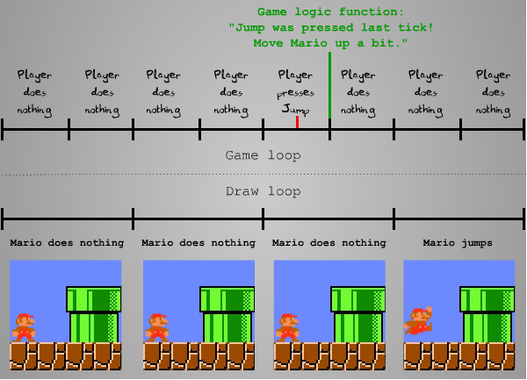

Slide 5
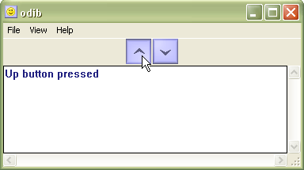

Slide 6

Systems
Handler
Manager
Manage or Handle:
Adding Entities/States
Removing Entities/States
Updating Entities/States
Drawing Entities/States

Slide 7
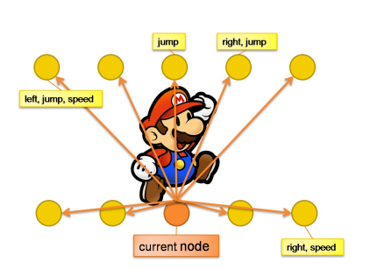
Update
Move
Jump
Speed
Animation
Direction
Max Speed
Jump Speed
Gravity

Slide 8

Move
Collision is checked
Verticle Collision
Horizontol Collision

Slide 9
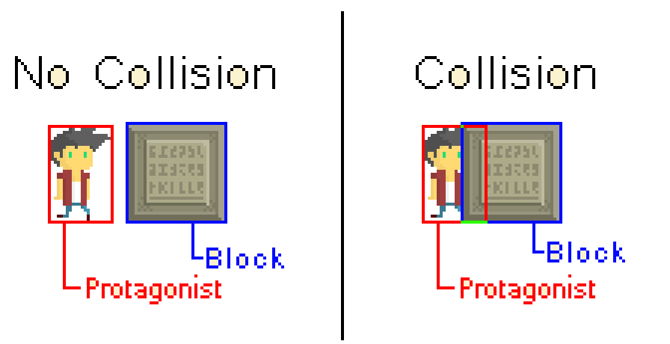
Collision
Boundaries are made
Intersection is checked
Axis-Aligned Bounding Box

Slide 10
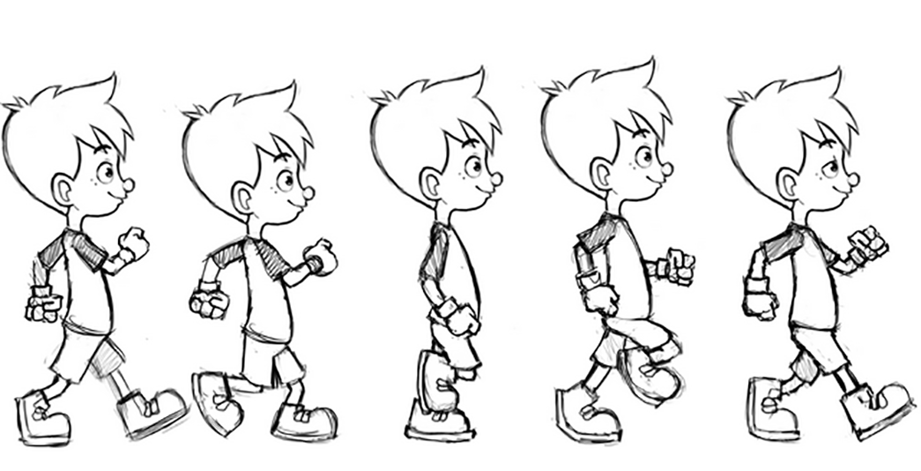
Animation
Changing image linearly
Change with small time period
Replaces current image

Slide 11
